Slide 1
Crime Management System
Crime Management System is a system used to report crimes. This project has been done using Java(Core) as front end, and Oracle SQL Database as back end. It can be used to report crimes. This project is mainly useful for police stations. This system will help to manage all the activities in a police station using computers. Currently all the works are done manually, by computerizing all the activities inside a police station can be managed easily and effectively.

Slide 2
Advantages of This System
The system is very simple in design and to implement. The system requires very low system resources and the system will work in almost all configurations. It has got following features:
Ensure data accuracy.
Proper control of the higher officials.
Reduce the damages of the machines.
Minimize manual data entry.
Minimum time needed for the various processing.
Greater efficiency.
Better service.
User friendliness and interactive.
Minimum time required.

Slide 3
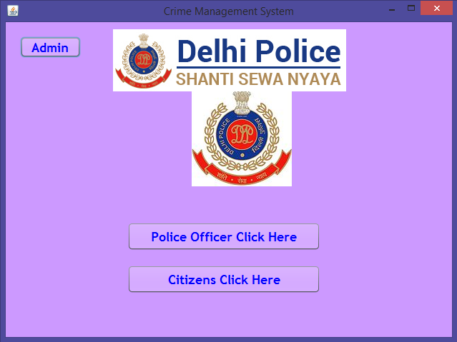
SCREENSHOTS
Home Page
This is the Home page of the project. Here are different buttons for Admin, Police and Citizens.

Slide 4
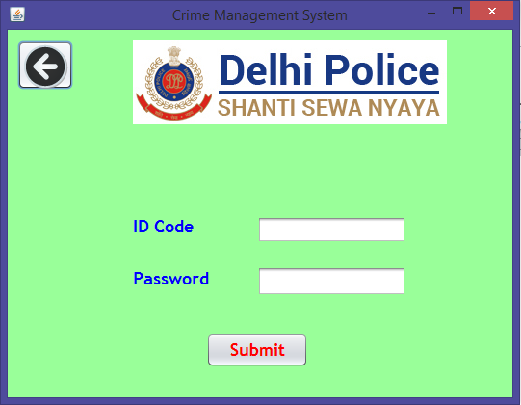
Police Login Page
This is the Login Page for the Police Officers. After entering correct details the user can have access to Police Home Page.

Slide 5
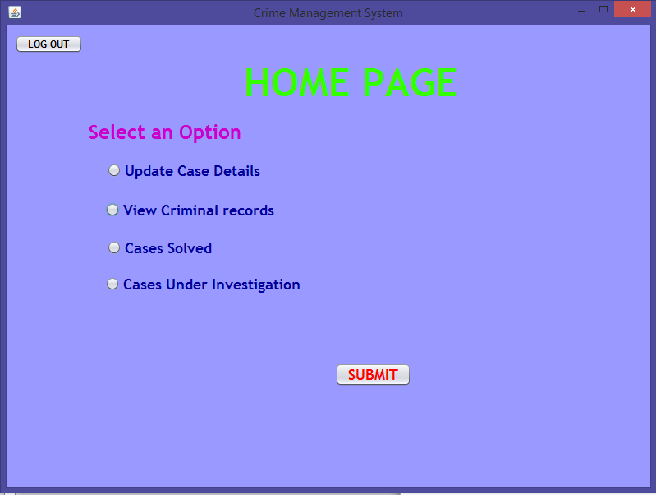
Police Home Page
This is the Home Page of Police Officers. Here the user can update or view the case details

Slide 6
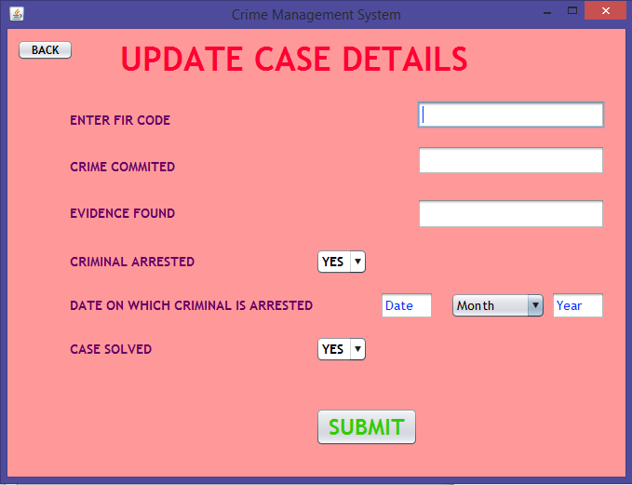
Update Case Details Page
Here the user can update the case details by entering the correct FIR code generated by the citizen FIR Registration.

Slide 7
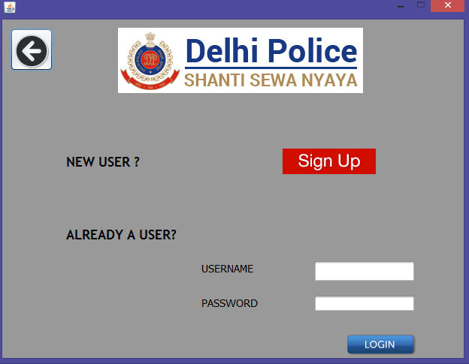
User Login Page
Here the user can enter the username and password to get access to User Home Page or click on sign up button.

Slide 8
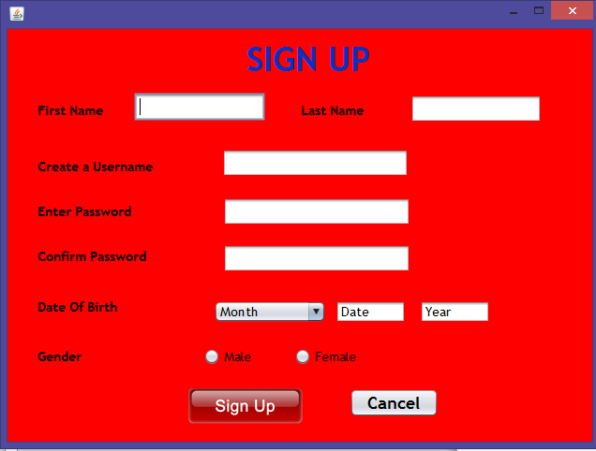
Sign up Page
Here the user can enter his correct details to get username and password for login.

Slide 9
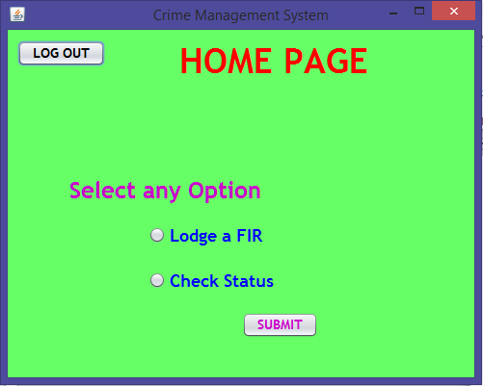
User Home Page
Here the user can Lodge a new FIR or check status for the previous one.

Slide 10
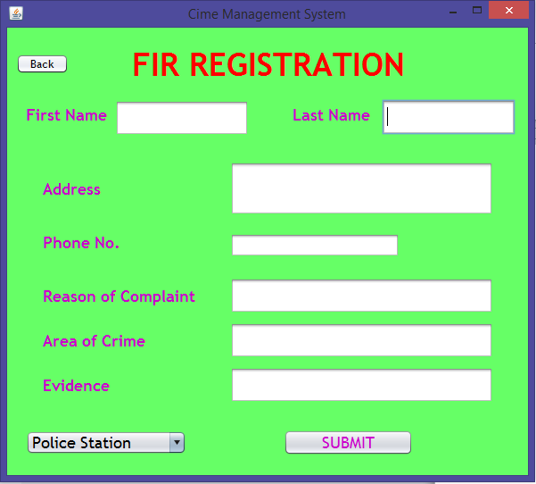
FIR Registration Page
Here the user can enter the criminal details to register an FIR and get FIR code.

Slide 11
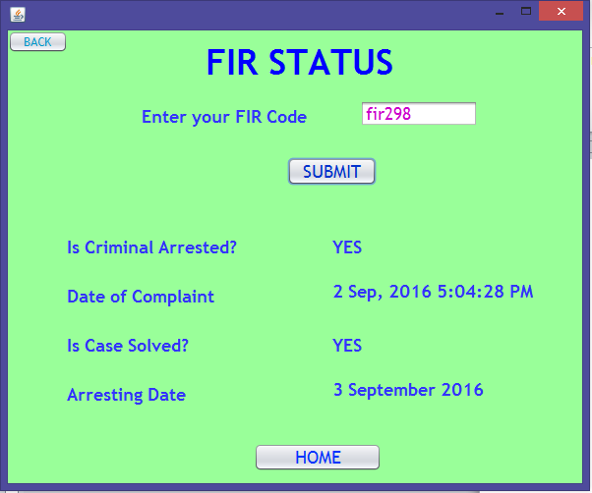
Check Status Page
Here the user can enter the FIR code to check status of the FIR.

Slide 12
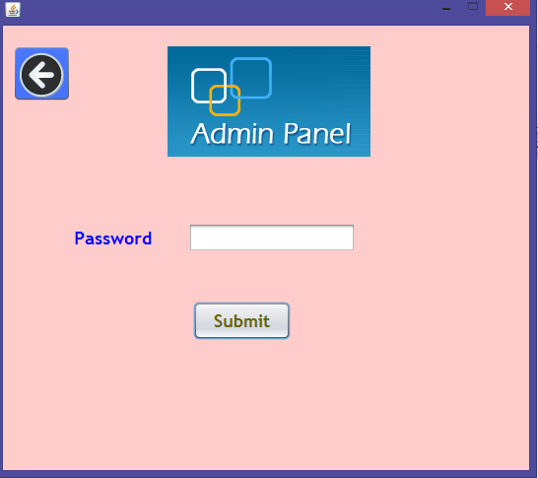
Admin Login Page
The Admin can enter the correct password and get access to Admin Panel.

Slide 13
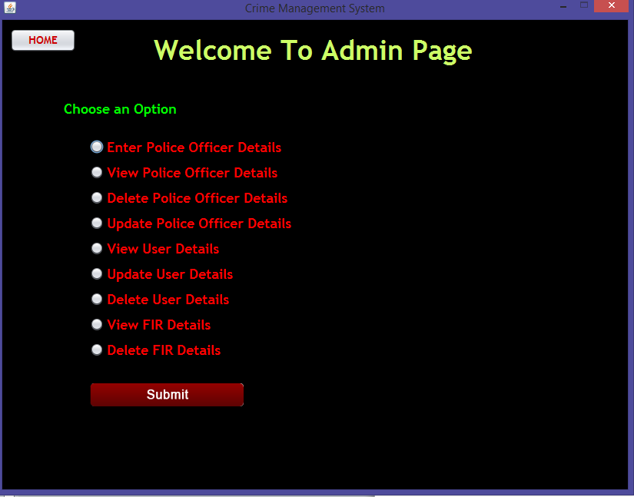
Admin Panel
Here The User can Access the whole Database and can update any details. The Admin can register new Police Codes or update/delete the previous ones.

Slide 14
Future Enhancement
We can update this system as online application.
The main advantage of online application is that, a person can report the crime any time from anywhere.
Users can view the progress of their complaint online.
By the future technology user can view the case details and progress of the complaints on their mobile phones.
Face recognition technology can apply. User or witness of the crime can give the physical information of the thief.

Slide 15
Conclusion
Crime Management System initiates the objective of providing the user with customized and powerful complaint registration and process management system side software. The software is built with all options such as complaint registration, police registration, and the citizens registration etc…All the requirements specified during the analysis and design phase are fully met, thus resulting in the formation of good software. The interface provided is very user friendly and flexible for all times. And as it created using java, the project is platform independent.

Slide 16
Thank You

